Slide 1
Roadmap for Many-core Visualization Software in DOE
Jeremy Meredith
Oak Ridge National Laboratory

Slide 2
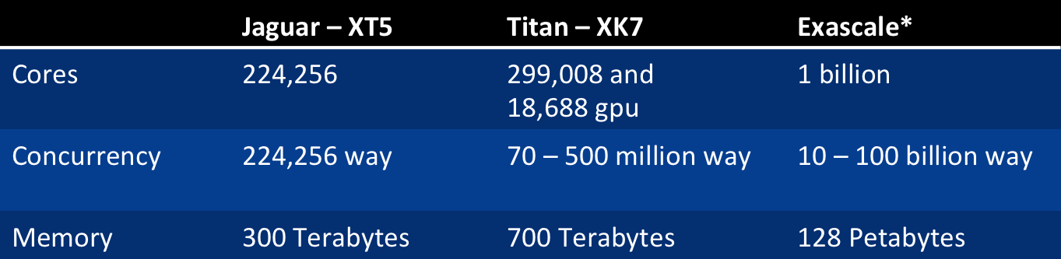
Supercomputers!
Supercomputer Hardware Advances Everyday
More and more parallelism
High-Level Parallelism
“The Free Lunch Is Over” (Herb Sutter)
Notes:
Optimizations tailored to a certain architecture will be obsolete when you implement it

Slide 3
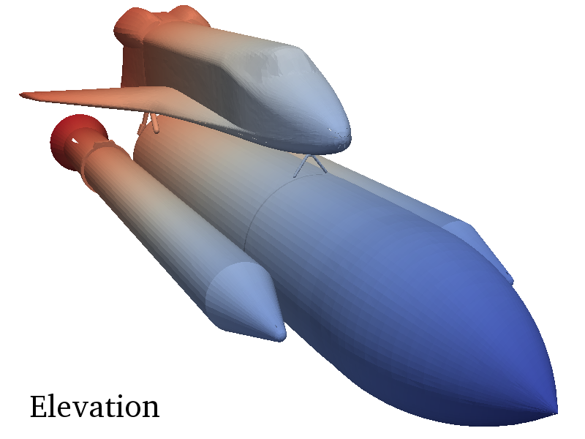
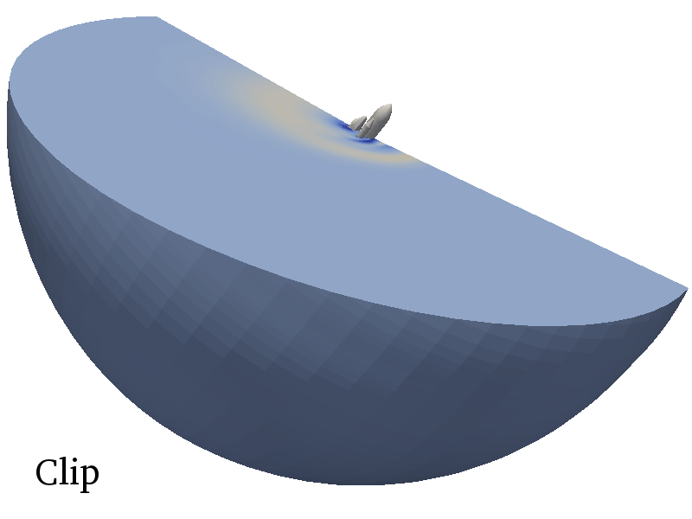
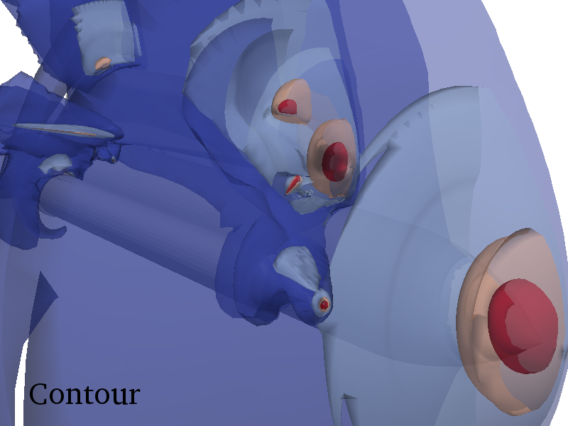
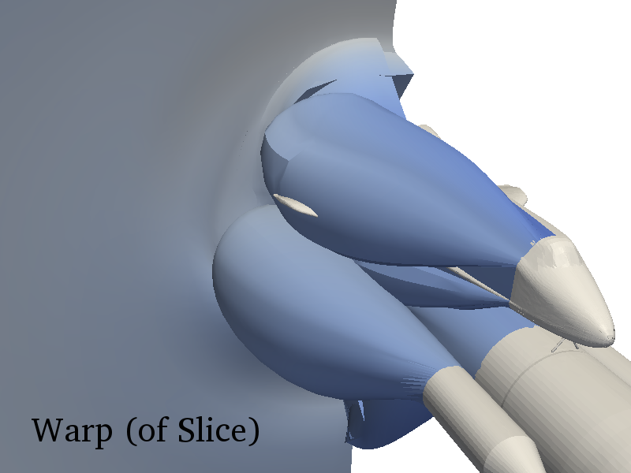
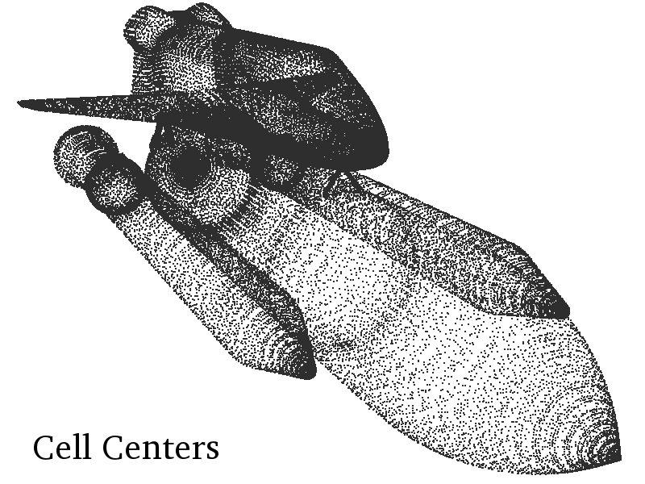
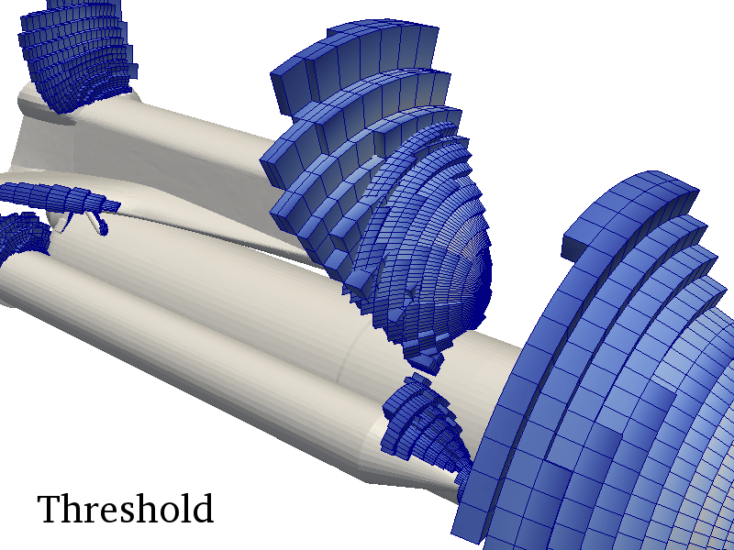
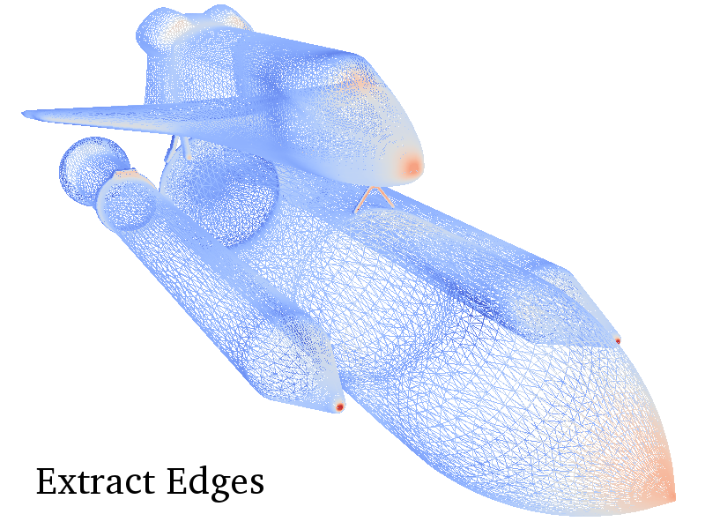
VTK-m Project
Combines the strengths of multiple projects:
EAVL, Oak Ridge National Laboratory
DAX, Sandia National Laboratory
PISTON, Los Alamos National Laboratory
Notes:
EAVL: DataModel
Dax: Worklets
Piston: Algorithms

Slide 4
VTK-m Goals
A single place for the visualization community to collaborate, contribute, and leverage massively threaded algorithms.
Reduce the challenges of writing highly concurrent algorithms by using data parallel algorithms
Notes:
We want to be one happy family to reduce the re-invention of algorithms. As VTK has become a location for researching classic cpu algorithms we want VTK-m to do the same for data parallel algorithm

Slide 5
VTK-m Goals
Make it easier for simulation codes to take advantage these parallel visualization and analysis tasks on a wide range of current and next-generation hardware.
Notes:
Both in-situ and post processing are our targets

Slide 6
VTK-m Architecture
Filters
Data Model
Post Processing
Worklets
In-Situ
Data Parallel Algorithms
Execution
Arrays
Notes:
Red is Pison
Blue is Dax
Green is Eavl
Array is finished,
Data Parallel Algorithms is nearing completion
Device Adapter is nearing completion
Actively working on getting DataModel into the code base
Use: represents the vtk level of access at a filter centric level
Develop: allow easy filter creation by combining worklets together, also a create level for direct integration with other applications that need only a set of specific algorithms
Research: the goal is to create an easy data parallel platform that allows people to research on new ways to construct algorithms or new algorithms.

Slide 7
VTK-m Architecture
Filters
Data Model
Post Processing
Worklets
In-Situ
Data Parallel Algorithms
Execution
Arrays
Notes:
Red is Pison
Blue is Dax
Green is Eavl
Array is finished,
Data Parallel Algorithms is nearing completion
Device Adapter is nearing completion
Actively working on getting DataModel into the code base
Use: represents the vtk level of access at a filter centric level
Develop: allow easy filter creation by combining worklets together, also a create level for direct integration with other applications that need only a set of specific algorithms
Research: the goal is to create an easy data parallel platform that allows people to research on new ways to construct algorithms or new algorithms.

Slide 8
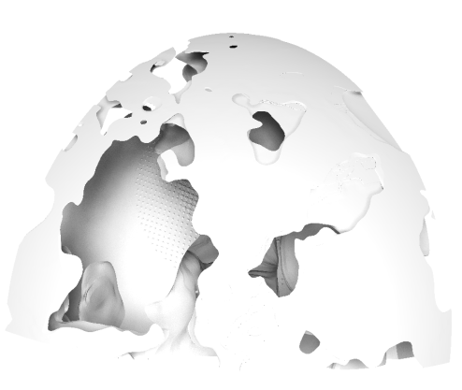
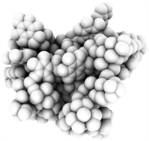
Extreme-scale Analysis and Visualization Library (EAVL)
EAVL enables advanced visualization and analysis for the next generation of scientific simulations, supercomputing systems, and end-user analysis tools.
New Mesh Layouts
Greater Memory Efficiency
More accurately represent simulation data in analysis results
Support novel simulation applications
Support future low-memory systems
Minimize data movement and transformation costs
Parallel Algorithm Framework
In Situ Support
Accelerator-based system support
Pervasive parallelism for multi-core and many-core processors
Direct zero-copy mapping of data from simulation to analysis codes
Heterogeneous processing models
J.S. Meredith, S. Ahern, D. Pugmire, R. Sisneros, "EAVL: The Extreme-scale Analysis and Visualization Library", Eurographics Symposium on Parallel Graphics and Visualization (EGPGV), 2012.
http://ft.ornl.gov/eavl

Slide 9
Gaps in Current Data Models
Traditional data set models target only common combinations of cell and point arrangements
This limits their expressiveness and flexibility
 |  | Point Arrangement
Cells | Coordinates | Explicit | Logical | Implicit | Hybrid
Structured | Strided | Structured Grid | ? | Image Data | ?
 | Separated | ? | Rectilinear Grid |  | ?
 | Hybrid | ? | ? |  | ?
Unstructured | Strided | Unstructured Grid | ? | ? | ?
 | Separated | ? | ? |  | ?
 | Hybrid | ? | ? |  | ?

Slide 10
Arbitrary Compositions for Flexibility
EAVL allows clients to construct data sets from cell and point arrangements that exactly match their original data
In effect, this allows for hybrid and novel mesh types
Native data results in greater accuracy and efficiency
 |  | Point Arrangement
Cells | Coordinates | Explicit | Logical | Implicit | Hybrid
Structured | Strided | ✓ | ✓ | ✓ | ✓
 | Separated | ✓ | ✓ | ✓ | ✓
 | Hybrid | ✓ | ✓ | ✓ | ✓
Unstructured | Strided | ✓ | ✓ | ✓ | ✓
 | Separated | ✓ | ✓ | ✓ | ✓
 | Hybrid | ✓ | ✓ | ✓ | ✓
EAVL Data Set

Slide 11
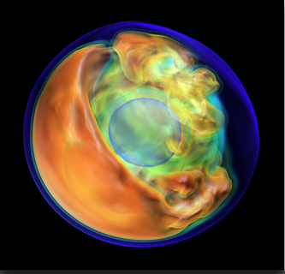
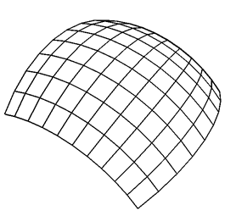
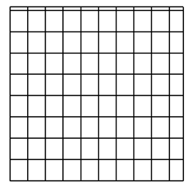


Other Data Model Gaps Addressed in EAVL
A
B
Low/high dimensional data
(9D mesh in GenASiS)
Multiple cell groups in one mesh
(E.g. subsets, face sets, flux surfaces)
Multiple simultaneous coordinate systems
(lat/lon + Cartesian xyz)
H
H
C
C
H
H
Non-physical data (graph, sensor, performance data)
Novel and hybrid mesh types
(quadtree grid from MADNESS)
Mixed topology meshes
(atoms + bonds, sidesets)

Slide 12
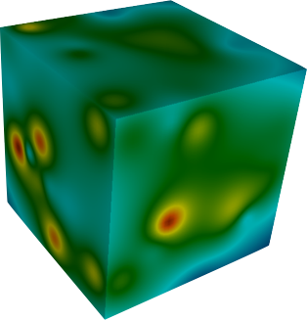
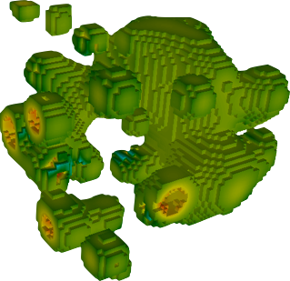
Memory Efficiency in EAVL
Data model designed for memory efficient representations
Lower memory usage for same mesh relative to traditional data models
Less data movement for common transformations leads to faster operation
Example: threshold data selection
7x memory usage reduction
5x performance improvement
35 < Density < 45

Slide 13
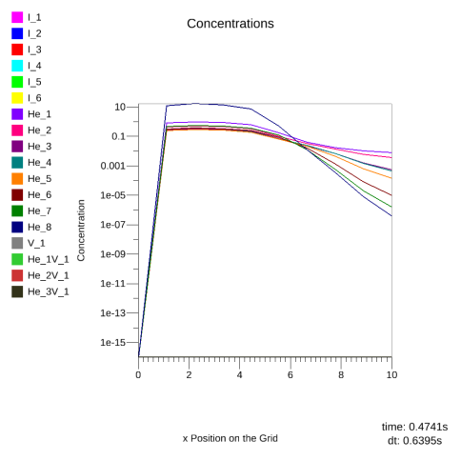
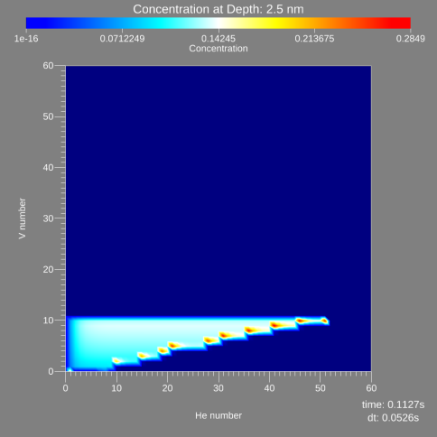
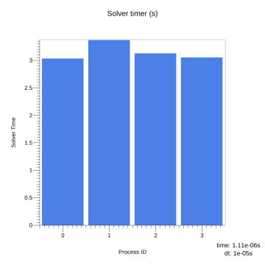
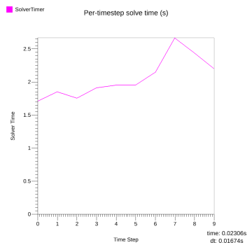
Tightly Coupled In Situ with EAVL
Efficient in situ visualization and analysis
light weight, zero-dependency library
zero-copy references to host simulation
heterogeneous memory support for accelerators
flexible data model supports non-physical data types
Example: scientific and performance visualization, tightly coupled EAVL with SciDAC Xolotl plasma/surface simulation
In Situ Scientific Visualization with Xolotl and EAVL
In Situ Performance Visualization with Xolotl and EAVL
Species concentrations across grid
Cluster concentrations at 2.5mm
Solver time for each MPI task
Solver time at each time step

Slide 14
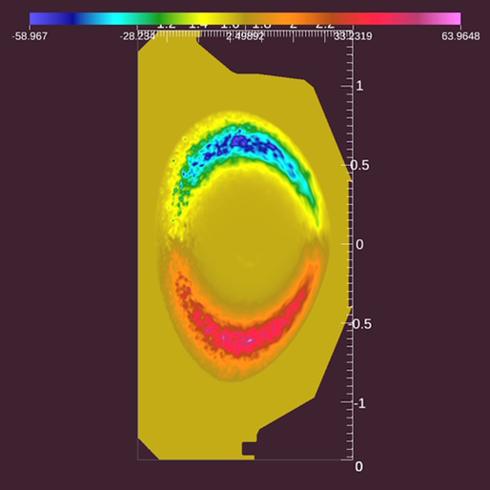
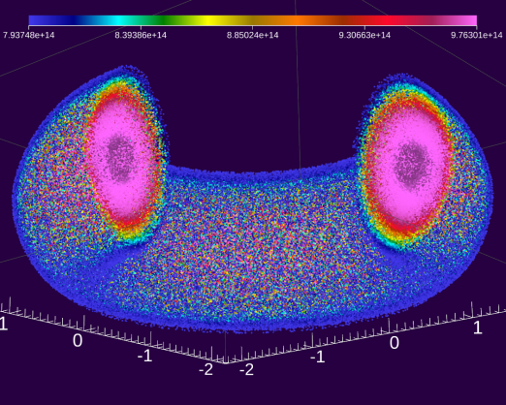
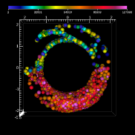
Loosely coupled In Situ with EAVL
Application de-coupled from visualization using ADIOS and Data Spaces
EAVL plug-in reads data from staging nodes
System nodes running EAVL perform visualization operations and rendering
Example: field and particle data, EAVL in situ with XGC SciDAC simulation via ADIOS and Data Spaces
Visualization of XGC field data from running simulation
HPC Application
Vis/Analysis
(EAVL)
ADIOS
ADIOS
Staging
(Data Spaces)
Visualization of XGC particles from running simulation. All particles (left), and selected subset of particles (right).
Supercomputer node layout for loosely coupled EAVL in situ
Viz

Slide 15
VTK-m Architecture
Filters
Data Model
Post Processing
Worklets
In-Situ
Data Parallel Algorithms
Execution
Arrays
Notes:
Red is Pison
Blue is Dax
Green is Eavl
Array is finished,
Data Parallel Algorithms is nearing completion
Device Adapter is nearing completion
Actively working on getting DataModel into the code base
Use: represents the vtk level of access at a filter centric level
Develop: allow easy filter creation by combining worklets together, also a create level for direct integration with other applications that need only a set of specific algorithms
Research: the goal is to create an easy data parallel platform that allows people to research on new ways to construct algorithms or new algorithms.

Slide 16
Data Parallelism in EAVL
Algorithm development framework in EAVL combines productivity with pervasive parallelism
Data parallel primitives map functors onto mesh-aware iteration patterns
Example: surface normal operation
strong performance scaling on multi-core and many-core devices (CPU, GPU, MIC/KNF)
Publications:
D. Pugmire, J. Kress, J.S. Meredith, N. Podhorszki, J. Choi, S. Klasky, “Towards Scalable Visualization Plugins for Data Staging Workflows”, 5th International Workshop on Big Data Analytics: Challenges and Opportunities (BDAC), 2014.
C. Sewell, J.S. Meredith, K. Moreland, T. Peterka, D. DeMarle, L.-T. Lo, J. Ahrens, R. Maynard, B. Geveci, "The SDAV Software Frameworks for Visualization and Analysis on Next-Generation Multi-Core and Many-Core Architectures", Seventh Workshop on Ultrascale Visualization (UltraVis), 2012.
J.S. Meredith, R. Sisneros, D. Pugmire, S. Ahern, "A Distributed Data-Parallel Framework for Analysis and Visualization Algorithm Development", Workshop on General Purpose Processing on Graphics Processing Units (GPGPU5), 2012.
J.S. Meredith, S. Ahern, D. Pugmire, R. Sisneros, "EAVL: The Extreme-scale Analysis and Visualization Library", Eurographics Symposium on Parallel Graphics and Visualization (EGPGV), 2012.

Slide 17
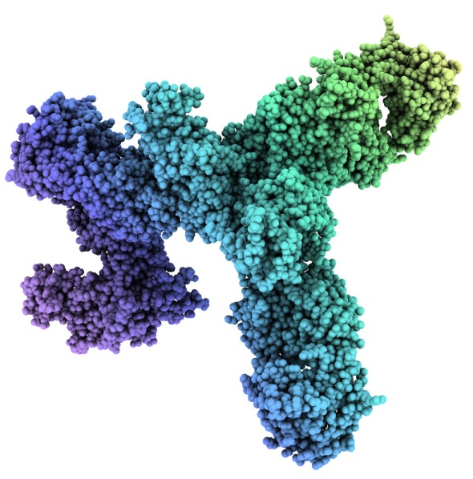
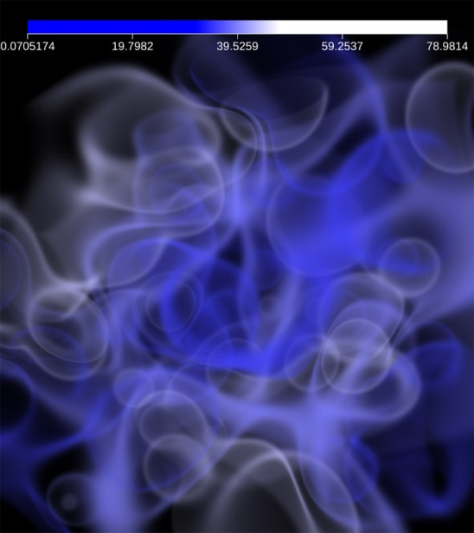
Advanced Rendering in EAVL
Advanced rendering capabilities
raster/vector, ray tracing, volume rendering
all GPU accelerated using EAVL’s data parallel API
parallel rendering support via MPI and IceT
Examples: ambient occlusion lighting effects highlight subtle shape cues for scientific understanding
Example: direct volume rendering achieves high accuracy images with GPU-accelerated performance
Shear-wave perturbations in SPECFEM3D_GLOBAL code
Ebola glycoprotein with proteins from survivor
Direct volume rendering from Shepard global interpolant

Slide 18
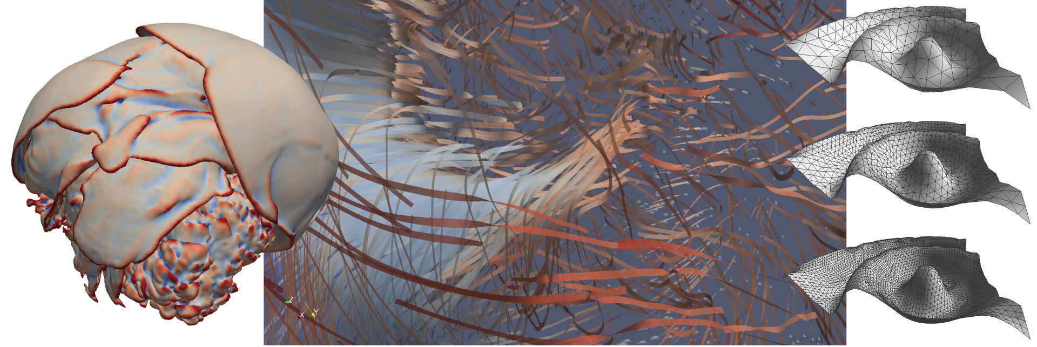



Dax: Data Analysis Toolkit for Extreme Scale
Kenneth Moreland Sandia National Laboratories
Robert Maynard Kitware, Inc.

Slide 19
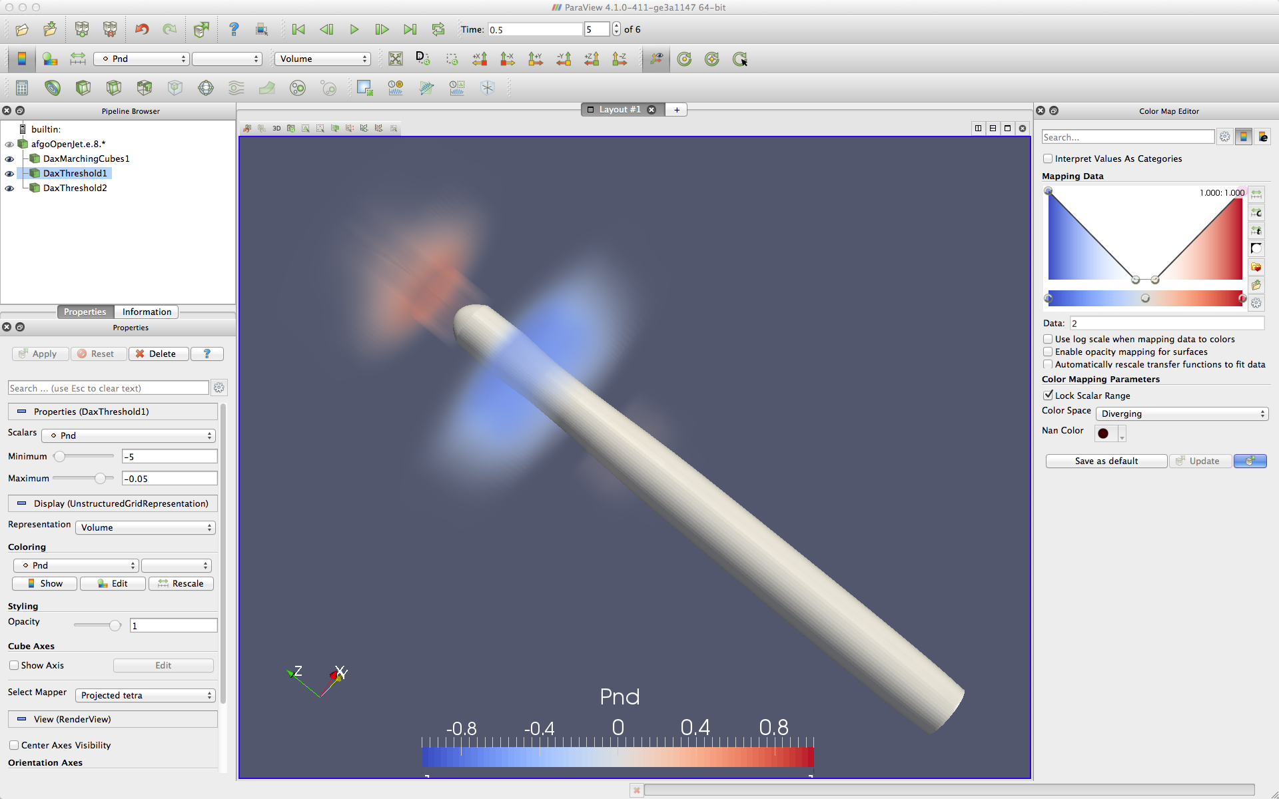
Dax Success
ParaView/VTK
Zero-copy support for vtkDataArray
Exposed as a plugin inside ParaView
Will fall back to cpu version
Notes:
2 threshold generated with dax and a contour

Slide 20
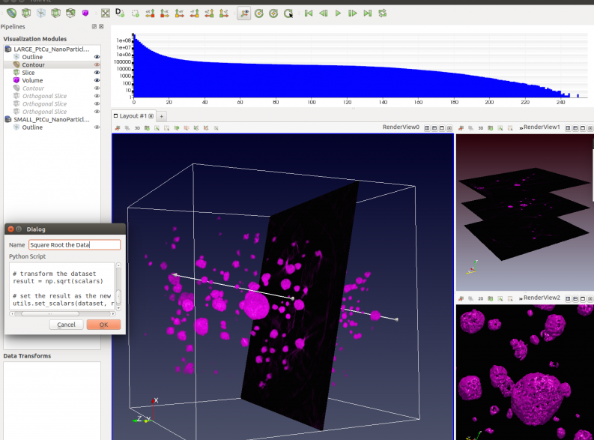
Dax Success
TomViz: an open, general S/TEM visualization tool
Built on top of ParaView framework
Operates on large (1024³ and greater) volumes
Uses Dax for algorithm construction
Implements streaming, interactive, incremental contouring
Streams indexed sub-grids to threaded contouring algorithms
Notes:
Scanning Transmission Electron Microscopes (S/TEM)
Desktop application

Slide 21
dax::cont::ArrayHandle<dax::Scalar> inputHandle =
dax::cont::make_ArrayHandle(input);
dax::cont::ArrayHandle<dax::Scalar> sineResult;
dax::cont::DispatcherMapField<Sine> dispatcher;
dispatcher.Invoke(inputHandle, sineResult);
Control Environment
Execution Environment
struct Sine: public dax::exec::WorkletMapField {
typedef void ControlSignature(FieldIn, FieldOut);
typedef _2 ExecutionSignature(_1);
DAX_EXEC_EXPORT
dax::Scalar operator()(dax::Scalar v) const {
return dax::math::Sin(v);
}
};

Slide 22
VTK-m Architecture
Filters
Data Model
Post Processing
Worklets
In-Situ
Data Parallel Algorithms
Execution
Arrays
Notes:
Red is Pison
Blue is Dax
Green is Eavl
Array is finished,
Data Parallel Algorithms is nearing completion
Device Adapter is nearing completion
Actively working on getting DataModel into the code base
Use: represents the vtk level of access at a filter centric level
Develop: allow easy filter creation by combining worklets together, also a create level for direct integration with other applications that need only a set of specific algorithms
Research: the goal is to create an easy data parallel platform that allows people to research on new ways to construct algorithms or new algorithms.

Slide 23
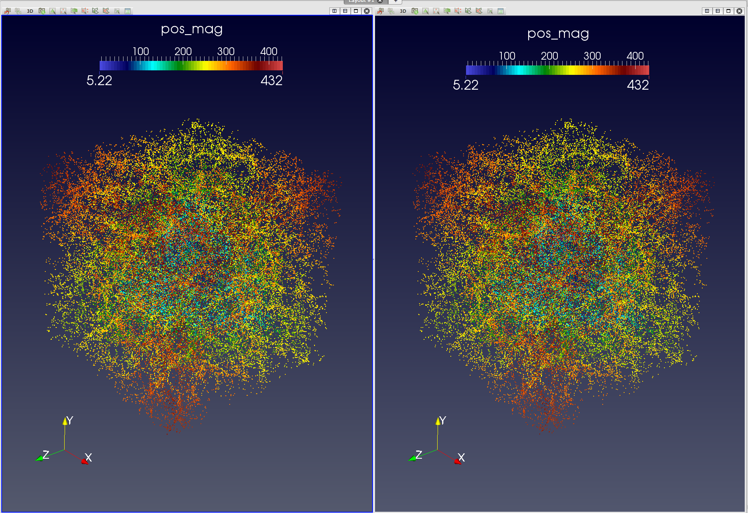
Results: Visual comparison of halos
Original Algorithm
PISTON Algorithm
Notes:
Here is a side-by-side visualization of the halos found by the original algorithm and by the PISTON algorithm. The accuracy of the results was verified by The accuracy of the results was verified by performing a diff on the FOF halo properties files produced by the two codes, which outputs the id, total mass, number of particles, and center for each halo. Reported MCP centers were sometimes different due to ties where more than one particle had the exact same number of friends, with both results being equally correct.

Slide 24
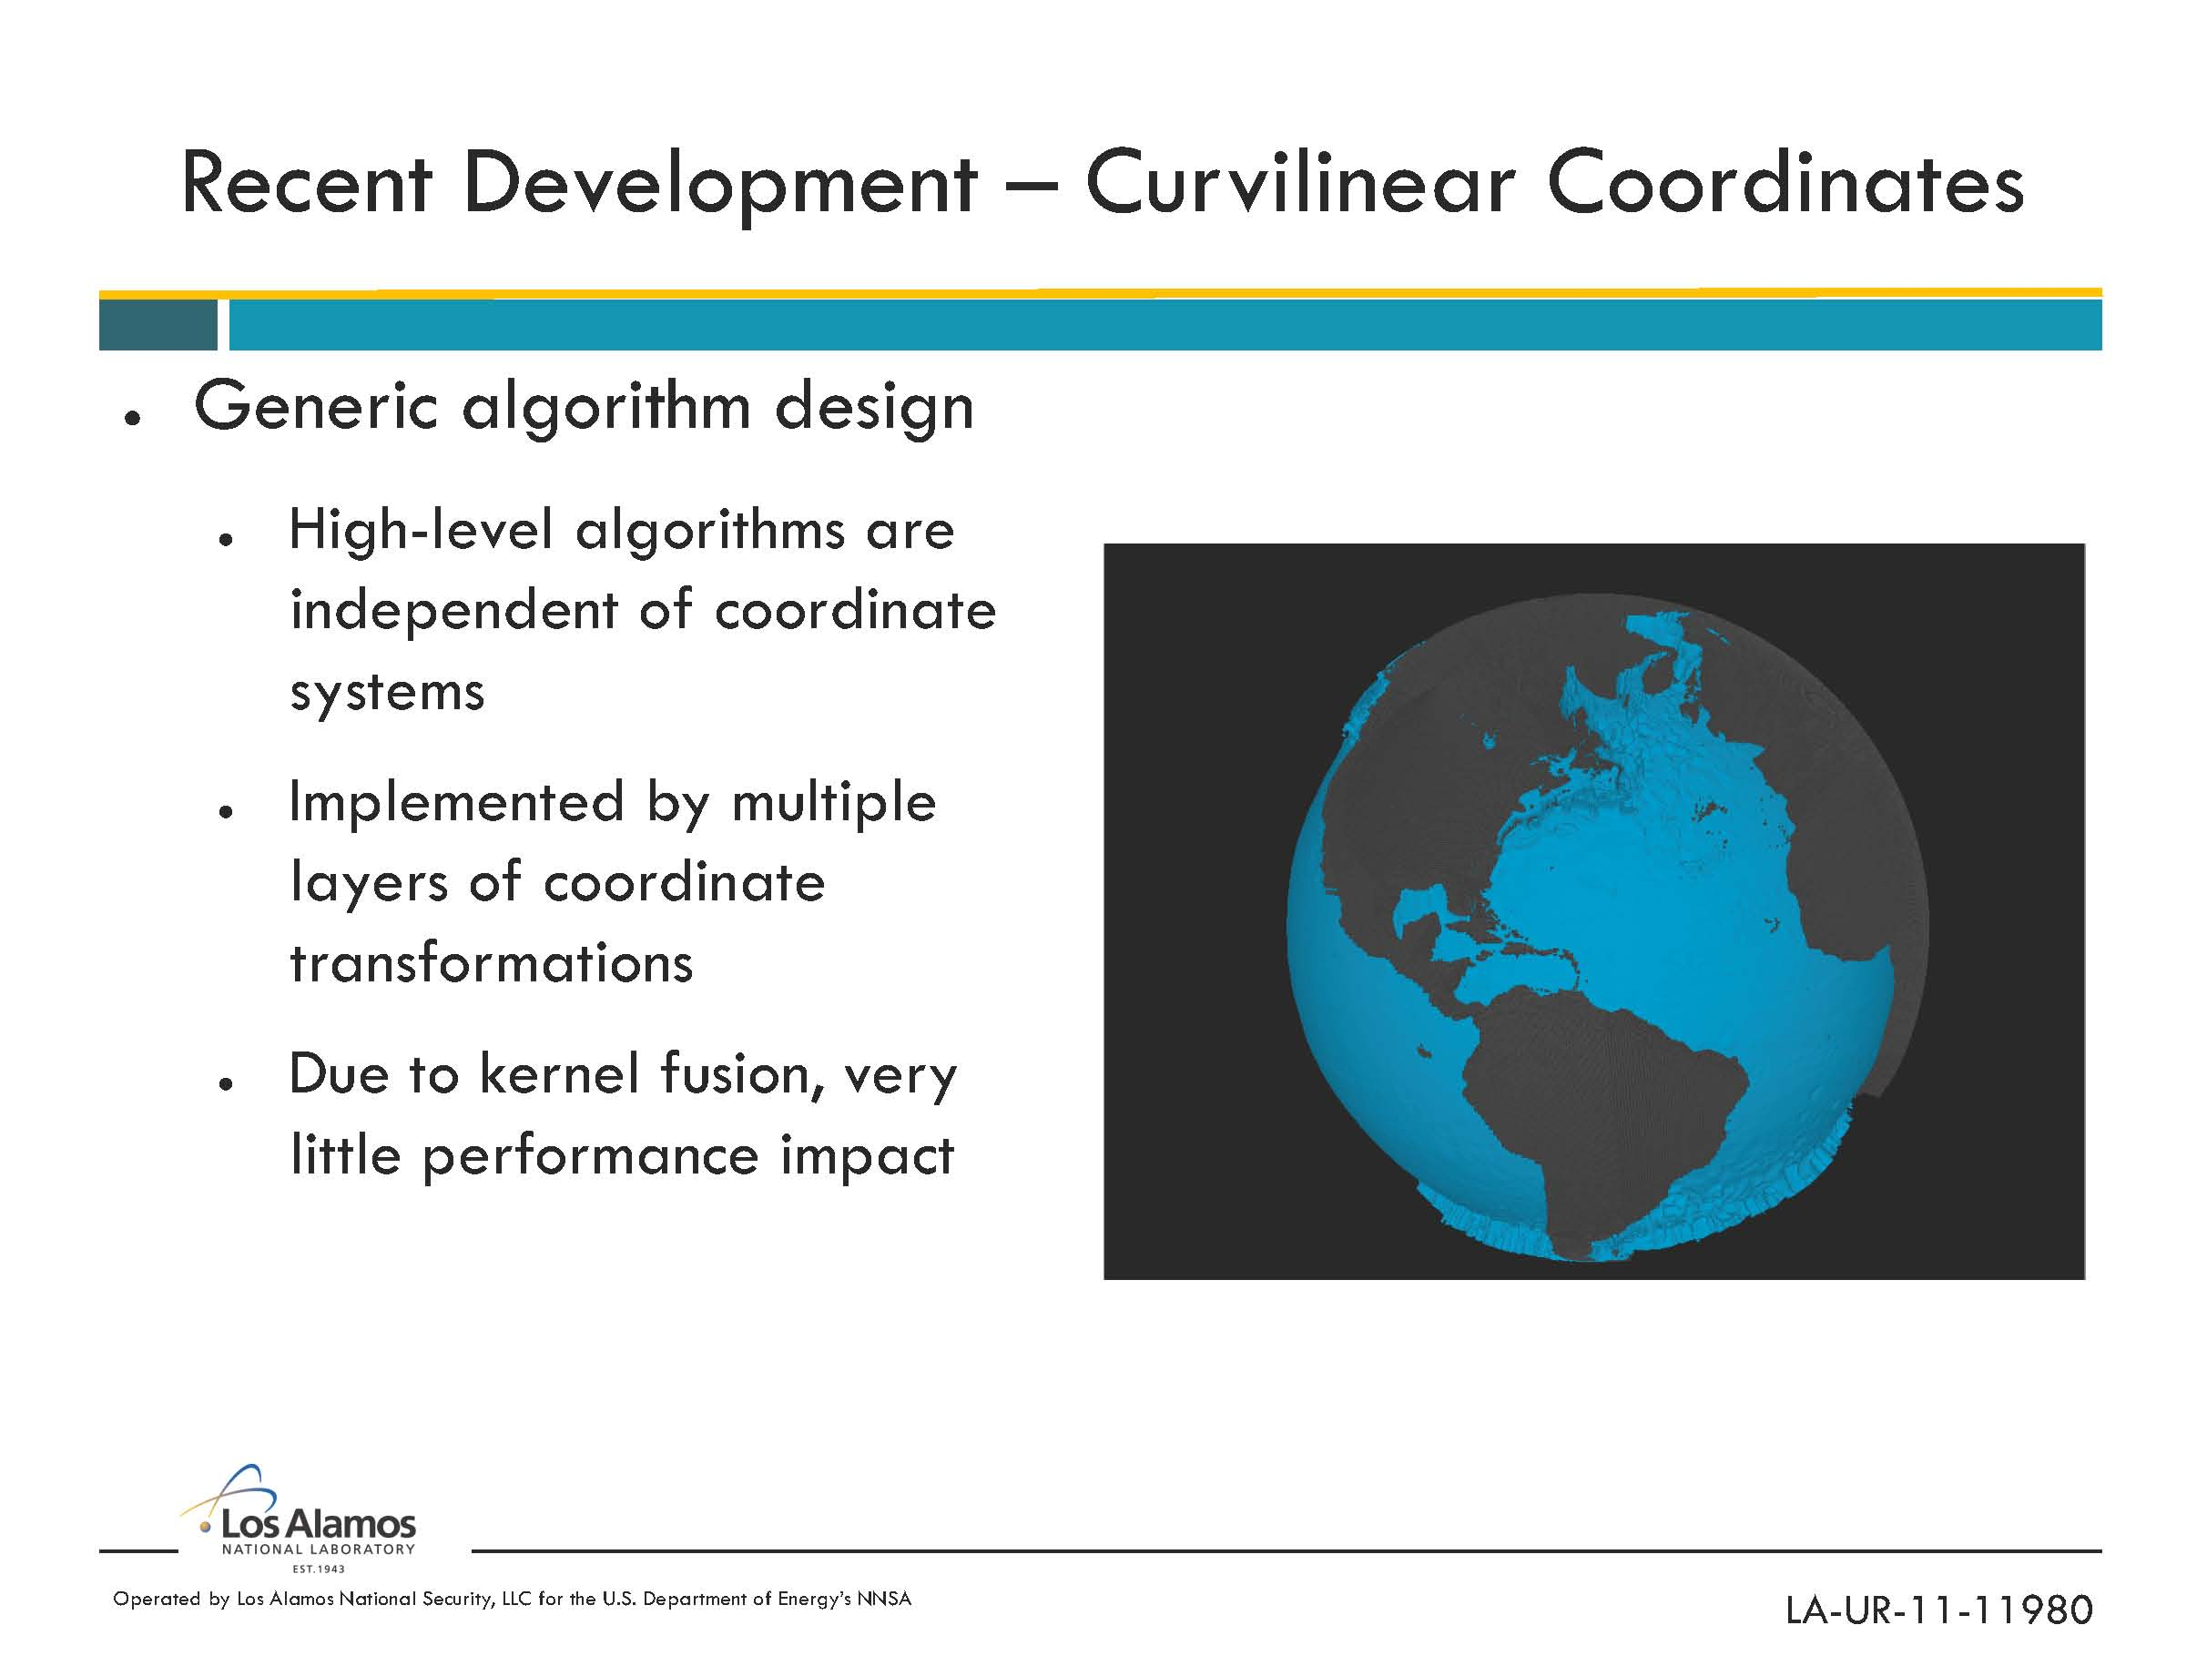
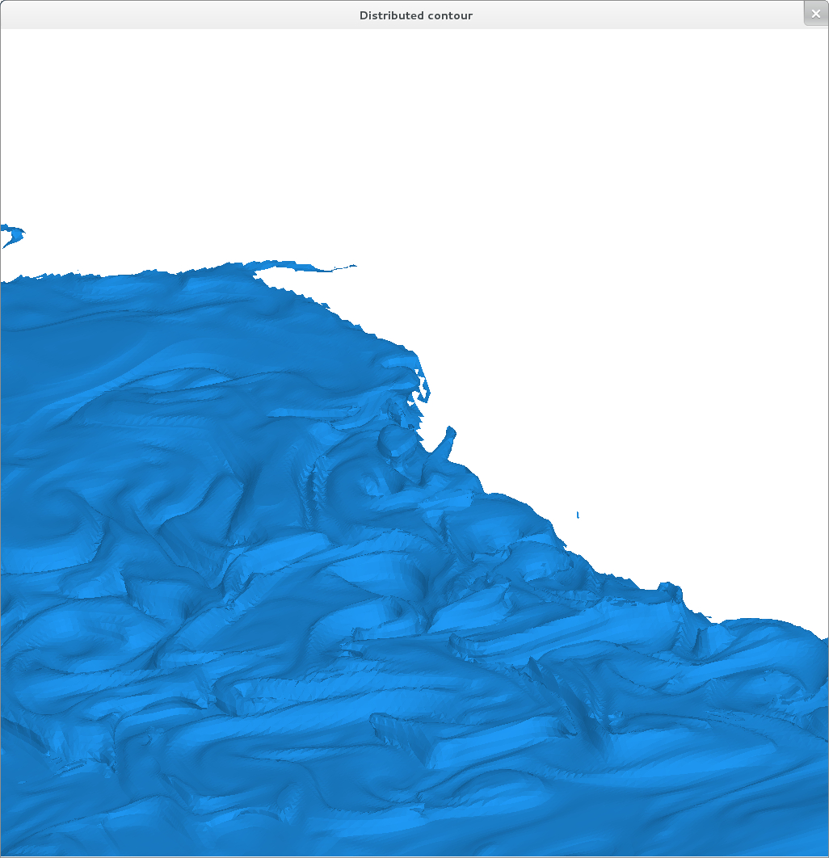
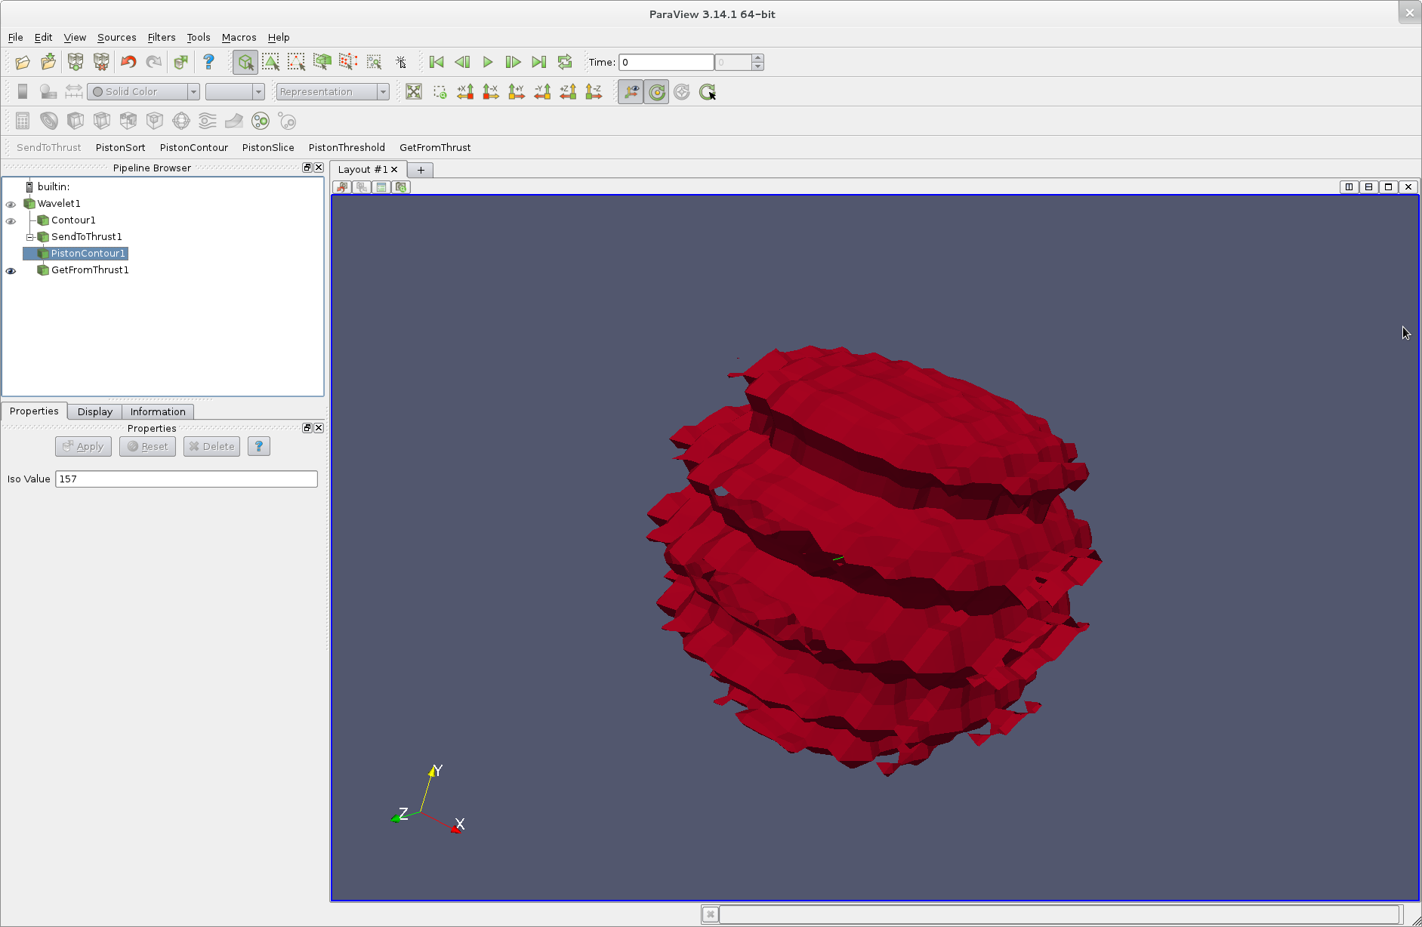
Piston
Focuses on developing data-parallel algorithms that are portable across multi-core and many-core architectures for use by LCF codes of interest
Algorithms are integrated into LCF codes in-situ either directly or though integration with ParaView Catalyst
PISTON isosurface with curvilinear coordinates
Ocean temperature isosurface generated across four GPUs using distributed PISTON
PISTON integration with VTK and ParaView
Notes:
The PISTON component of VTK-m focuses on developing data-parallel algorithms that are portable across multi-core and many-core architectures for use by LCF codes of interest.
PISTON consists of a library of visualization and analysis algorithms implemented using NVIDIA’s Thrust library, as well as a set of extensions to Thrust.
PISTON algorithms are integrated into LCF codes in-situ either directly or though integration with ParaView Catalyst.

Slide 25
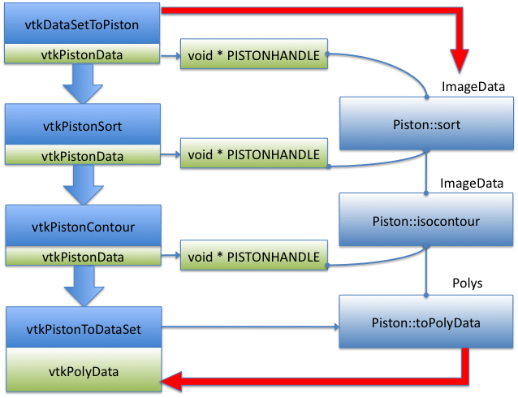
Integration with VTK and ParaView
Filters that use PISTON data types and algorithms integrated into VTK and ParaView
Utility filters interconvert between standard VTK data format and PISTON data format (thrust device vectors)
Supports interop for on-card rendering

Slide 26
Distributed Parallel Halo Finder
Particles are distributed among processors according to a decomposition of the physical space
Overload zones (where particles are assigned to two processors) are defined such that every halo will be fully contained within at least one processor
Each processor finds halos within its domain: Drop in PISTON multi-/many-core accelerated algorithms
At the end, the parallel halo finder performs a merge step to handle “mixed” halos (shared between two processors), such that a unique set of halos is reported globally
Notes:
Our PISTON halo finder can then be substituted in as a drop-in replacement for the serial halo finder that runs within each MPI rank.

Slide 27
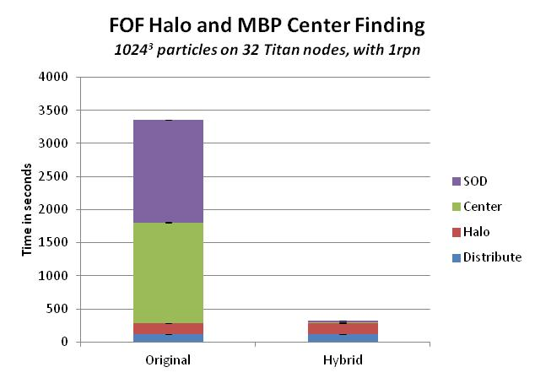
Distributed Parallel Halo Finder
Performance Improvements
On Moonlight with 1024³ particles on 128 nodes with 16 processes per node, PISTON on GPUs was 4.9x faster for halo + most bound particle center finding
On Titan with 1024³ particles on 32 nodes with 1 process per node, PISTON on GPUs was 11x faster for halo + most bound particle center finding
Implemented grid-based most bound particle center finder using a Poisson solver that performs fewer total computations than standard O(n²) algorithm
Science Impact
These performance improvements allowed halo analysis to be performed on a very large 8192³ particle data set across 16,384 nodes on Titan for which analysis using the existing CPU algorithms was not feasible
Publications
Submitted to PPoPP15: “Utilizing Many-Core Accelerators for Halo and Center Finding within a Cosmology Simulation” Christopher Sewell, Li-ta Lo, Katrin Heitmann, Salman Habib, and James Ahrens
This test problem has ~90 million particles per process.
Due to memory constraints on the GPUs, we utilize a hybrid approach, in which the halos are computed on the CPU but the centers on the GPU.
The PISTON MBP center finding algorithm requires much less memory than the halo finding algorithm but provides the large majority of the speed-up, since MBP center finding takes much longer than FOF halo finding with the original CPU code.
Notes:
Our next goal was to accelerate the analysis for a very large 81923 particle simulation on Titan. Because the memory requirements increase with the number of MPI processes due to overload regions, the HACC simulation with this data can only use one MPI process per node, along with the associated GPU, given the memory available on Titan. This creates a significant bottleneck for the original serial-per-process halo and center finding code, as it essentially leaves 15 of 16 cores on each node idle. Thus, there is an even greater potential for speed-up by utilizing the GPUs for analysis. However, this configuration also results in a very large number of particles per process (about 90 million). Due to the memory requirements for binning the particles, the 6 GB GPU memories cannot hold all of the data structures necessary for efficient FOF halo finding at once. A long-term solution for this issue would be to implement the algorithms using a streaming interface that could compute results without ever having to hold all the data in memory at once. Another option was to utilize a hybrid approach, in which the halos are computed on the CPU but the centers on the GPU. The PISTON MBP center finding algorithm requires much less memory than the halo finding algorithm, but provides the large majority of the speed-up. For this test, we also computed SOD halos from the FOF halo centers using the original CPU code, but using the PISTON code for computing MBP centers of the SOD halos.
Using this hybrid implementation on a 1024^3 data set using 32 processors with one process per node, the total time to compute FOF and SOD halos and find the MBP centers for each was about 56 minutes using only the original CPU code, and about five minutes when using the PISTON code on the GPU to find the MBP centers. The original CPU code spent a total of 3089 seconds for MBP center finding, while the PISTON code on the GPU spent only 28 seconds. This is about a two-order-of-magnitude (110x) improvement for the MBP center finding, and about a one-order of-magnitude (11x) improvement for the total analysis computation.

Slide 28
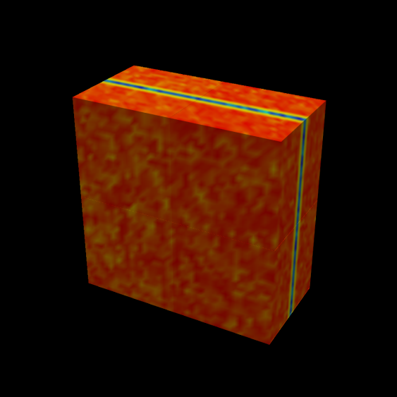
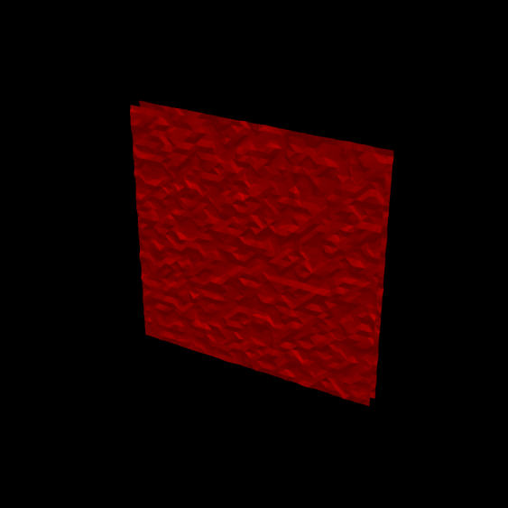
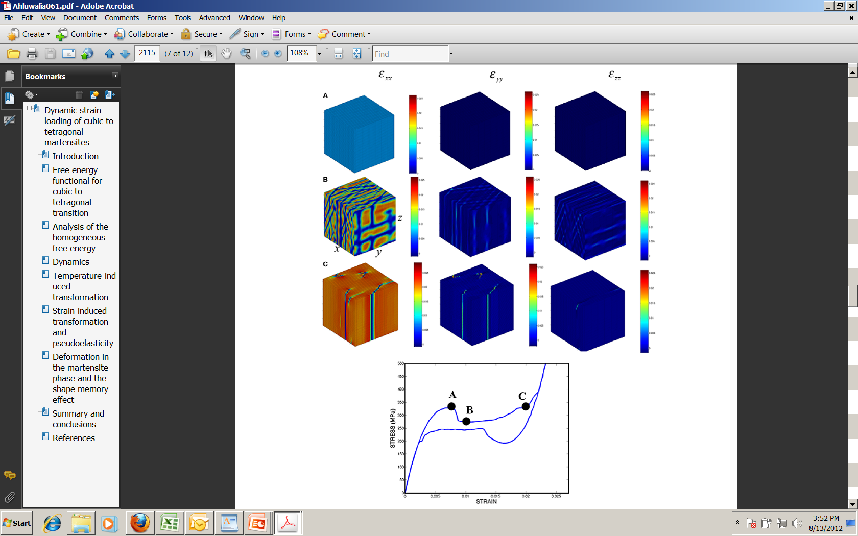
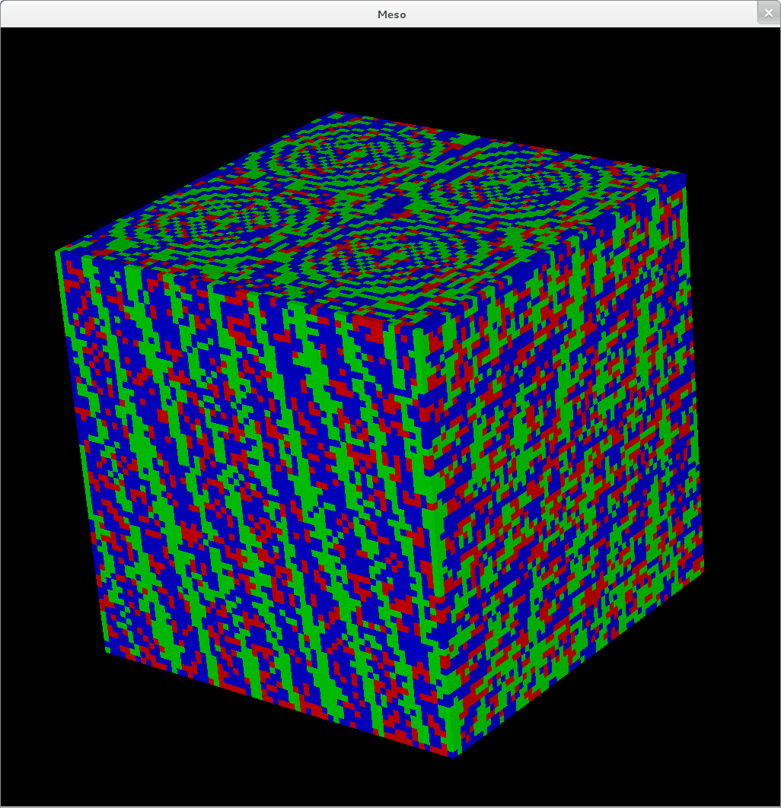
PISTON In-Situ
VPIC (Vector Particle in Cell) Kinetic Plasma Simulation Code
Implemented first version of an in-situ adapter based on Paraview CoProcessing Library (Catalyst)
Three pipelines: vtkDataSetMapper, vtkContourFilter, vtkPistonContour
CoGL
Stand-alone meso-scale simulation code developed as part of the Exascale Co-Design Center for Materials in Extreme Environments
Studies pattern formation in ferroelastic materials using the Ginzburg–Landau approach
Models cubic-to-tetragonal transitions under dynamic strain loading
Simulation code and in-situ viz implemented using PISTON
Output of vtkDataSetMapper and vtkPistonContour filters on Hhydro charge density at one timestep of VPIC simulation
Strains in x,y,z (above); PISTON in-situ visualization (right)

Slide 29
VTK-m Combines Dax, PISTON, EAVL

Slide 30
A Traditional Data Set Model
Data Set
Rectilinear
Structured
Unstructured
Dimensions
3D Axis Coordinates
Cell Fields
Point Fields
Dimensions
3D Point Coordinates
Cell Fields
Point Fields
Connectivity
3D Point Coordinates
Cell Fields
Point Fields

Slide 31
The VTK-m Data Set Model
CellSet
Data Set
Cells[]
Points[]
Fields[]
Explicit
Structured
QuadTree
Subset
Connectivity
Dimensions
Tree
CellList
Coords
Field
FieldName
Component
Name
Association
Values

Slide 32
VTK-m Framework
Control Environment
Execution Environment
vtkm::cont
vtkm::exec
Notes:
The VTK-m framework is divided into two distinct environments each with their own API.
The control environment a serial environment that is used to establish data and set up parallel jobs.
This is the interface used to connect VTK-m to applications and other code.
The API for the control environment is located in the namespace vtkm::cont.
The execution environment is the parallel environment where the actual data processing is done.
Internally, the control environment spawns parallel jobs in the execution environment.
The API for the execution environment is located in the namespace vtkm::exec.
These two environments mirror the typical hardware configuration of general purpose CPU and accelerator coprocessor.
But also work fine when both are integrated.

Slide 33
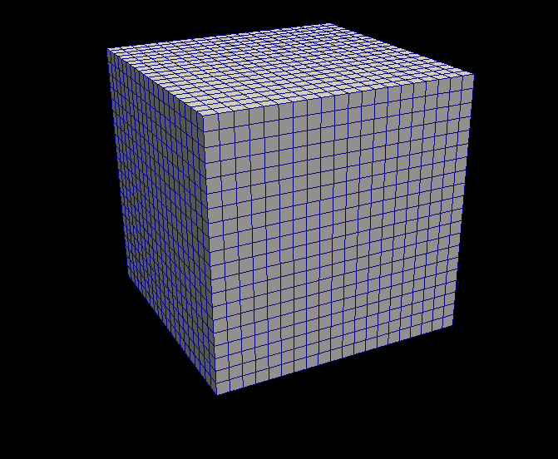
VTK-m Framework
Control Environment
Grid Topology
Array Handle
Invoke
Execution Environment
vtkm::cont
vtkm::exec
Notes:
When processing data in VTK-m, you first establish the data topology through the control environment.
This is done through very basic grid topology structures and adaptable array handles.

Slide 34
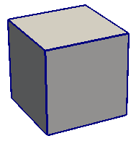
VTK-m Framework
Control Environment
Grid Topology
Array Handle
Invoke
Execution Environment
Cell Operations
Field Operations
Basic Math
Make Cells
Worklet
vtkm::cont
vtkm::exec
Notes:
Then from the control environment you can invoke an algorithm on your data.
Internally, this will decompose the data into constitute pieces, transfer data as necessary, and invoke a parallel algorithm.
Algorithms in the execution environment are built using worklets.
Worklets are serial functors that operate on one constituent element.
The execution API provides the basic operations for cells, interpolations, derivatives, and other math.
Worklets come in different types with different abilities.

Slide 35
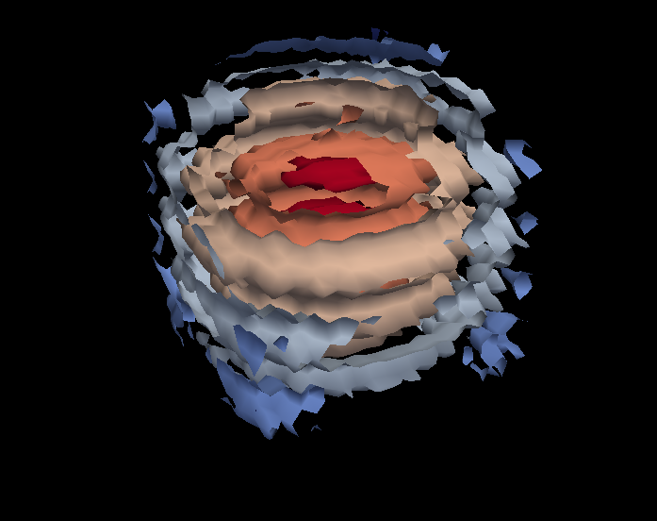
VTK-m Framework
Control Environment
Grid Topology
Array Handle
Invoke
Execution Environment
Cell Operations
Field Operations
Basic Math
Make Cells
Worklet
vtkm::cont
vtkm::exec
Notes:
And eventually the results are passed back to the control environment.

Slide 36
VTK-m Framework
Control Environment
Grid Topology
Array Handle
Invoke
Execution Environment
Cell Operations
Field Operations
Basic Math
Make Cells
Device Adapter
Allocate
Transfer
Schedule
Sort
…
Worklet
vtkm::cont
vtkm::exec
Notes:
These two environments, particularly the execution environment, are meant to work on a variety of architectures.
To manage this portability, we have a unit called a device adapter that sits between these two environments.
The device adapter provides the basic memory management, scheduling, and algorithms needed to run on a parallel device.

Slide 37
Device Adapter Contents
Tag (struct DeviceAdapterFoo { };)
Execution Array Manager
Schedule
Scan
Sort
Other Support algorithms
Stream compact, copy, parallel find, unique
Control Environment
Execution Environment
Transfer
Schedule
worklet
worklet
worklet
functor
worklet
worklet
worklet
worklet
functor
Compute
8
3
5
5
3
6
0
7
4
0
8
11
16
21
24
30
30
37
41
41
8
3
5
5
3
6
0
7
4
0
Compute
0
0
3
3
4
5
5
6
7
8

Slide 38
VTK-m Arbitrary Composition
VTK-m allows clients to access different memory layouts through the Array Handle and Dynamic Array Handle.
Allows for efficient in-situ integration
Allows for reduced data transfer
Control Environment
Execution Environment
Transfer
Control Environment
Execution Environment
Transfer

Slide 39
[Baker, et al. 2010]
Functor Mapping
Applied to Topologies
functor()
Notes:
Our basic approach to portable and efficient multicore algorithms is essentially that presented by Baker and colleagues.
Break the algorithm into sections that can be run on single (or small) sections of data and encapsulate that in a C++ functor object.
Using generic programming, provide a mapping function to schedule the functor on many threads to concurrently process a vector.
Dual benefits:
Simplifies algorithm design by placing the bulk of the work in a serial functor.
One porting of the map function to multiple parallel systems can be applied to any number of functor algorithms. Also works well in lightweight thread environment.
However, we find this basic model a bit too simplistic.
We are most interested in mapping operations to connected topologies, which means that the inputs and outputs of the operations are dependent on these connections.
For example, the computation of an operation may depend on a collection of data around a small neighborhood.

Slide 40
[Baker, et al. 2010]
Functor Mapping
Applied to Topologies
functor()
Notes:
We also have to consider that the values created by a functor may not be independent
For example, they might combine together to form a connected topology
If necessary, we might need to rebuild these connections

Slide 41
2 x Intel Xeon CPU E5-2620 v3 @ 2.40GHz + NVIDIA Tesla K40c

Slide 42
2 x Intel Xeon CPU E5-2620 v3 @ 2.40GHz + NVIDIA Tesla K40c
Data: 432^3

Slide 43
What We Have So Far
Features
Core Types
Statically Typed Arrays
Dynamically Typed Arrays
Device Interface (Serial, CUDA, and TBB)
Basic Worklet and Dispatcher

Slide 44
What We Have So Far
Compiles with
gcc (4.8+), clang, msvc (2010+), icc, and pgi
User Guide work in progress
Ready for larger collaboration

Slide 45
Questions?
m.vtk.org

